Slide 1
Food Oasis
Team 8 - Erys Dennis, Daniel Lee,
Josiah Das, Zoe Romocki

Slide 2
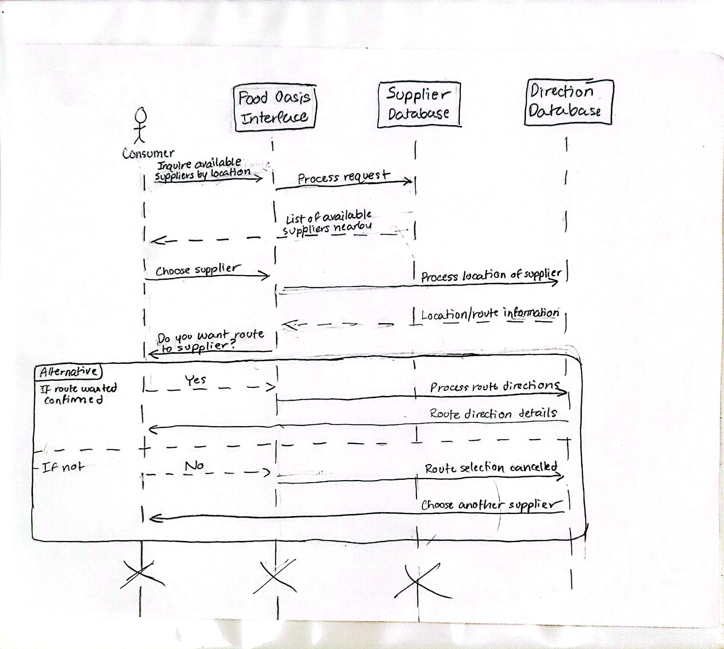
UML Sequence Diagram

Slide 3
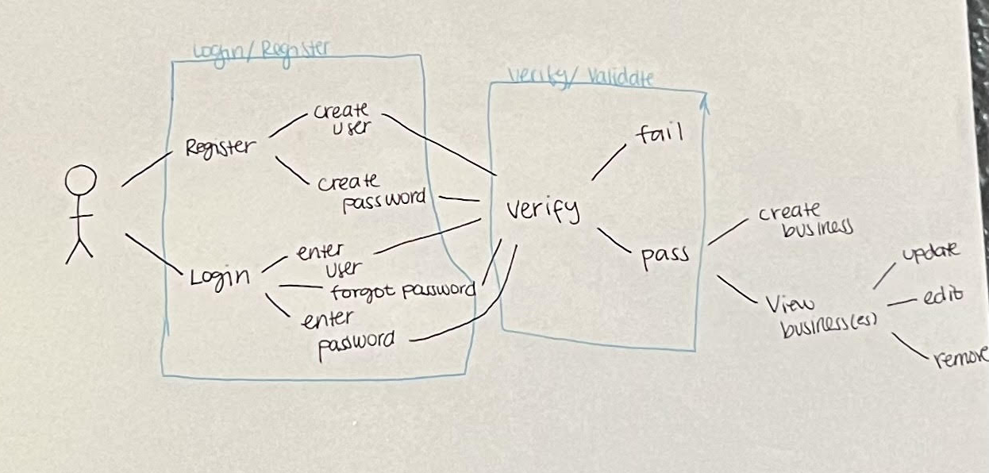
Use Case 1 - Supplier

Slide 4
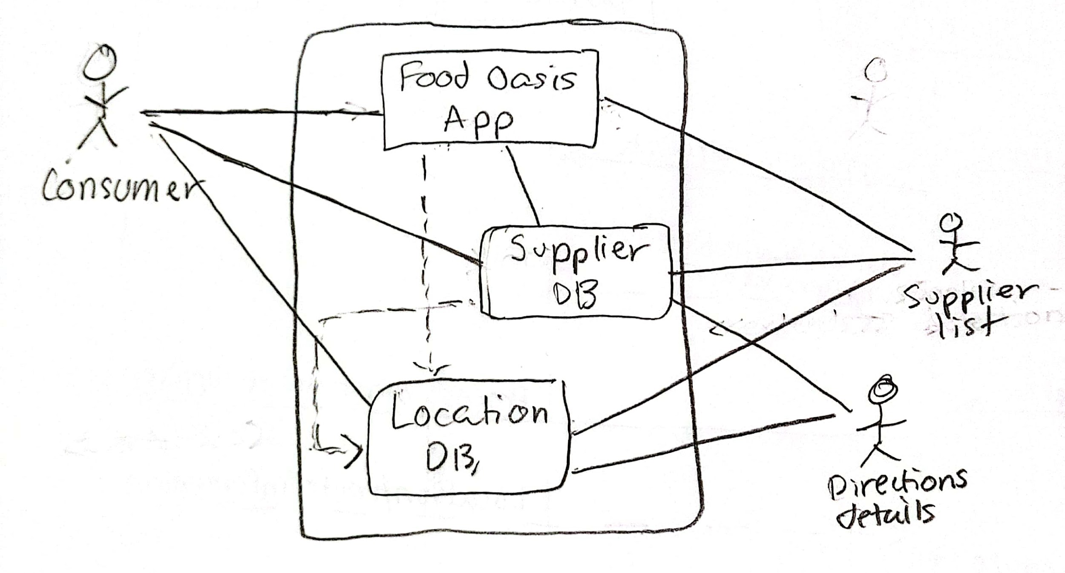
Use Case 2 - Consumer

Slide 5
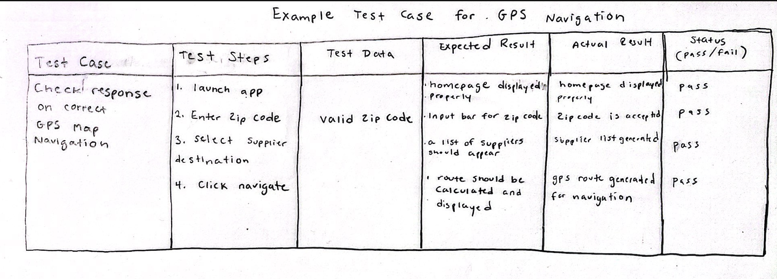
Test Case 1

Slide 6
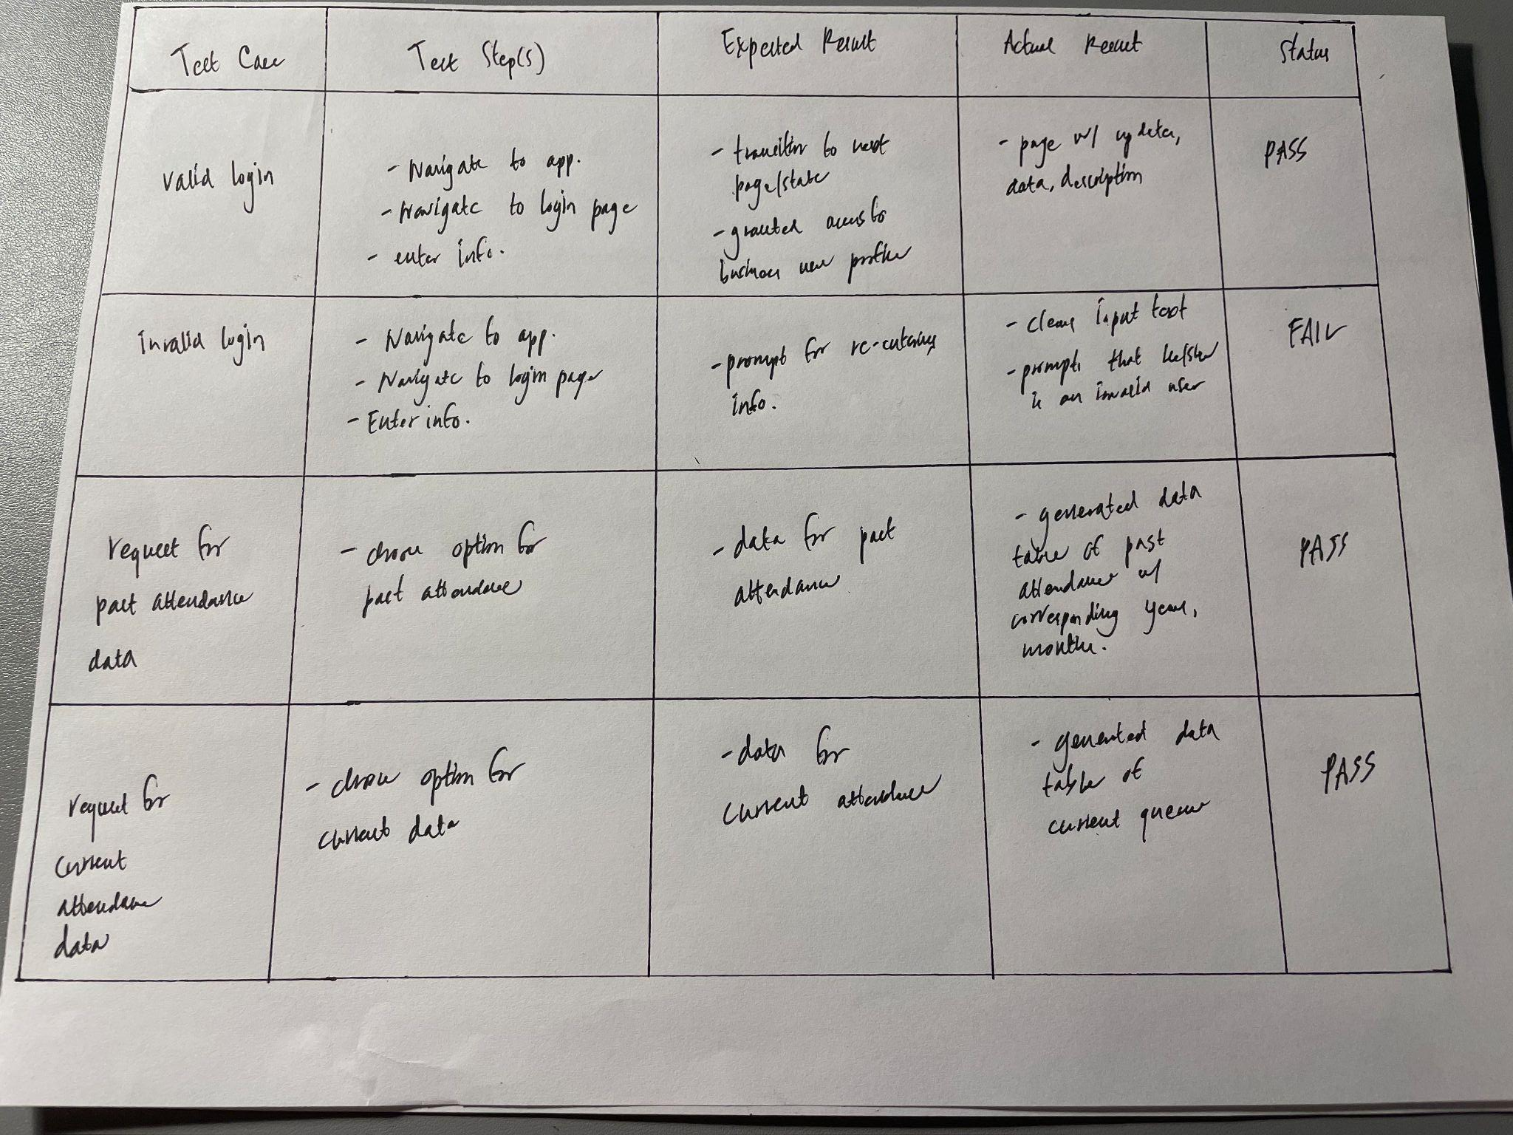
Test Case 2

Slide 7
Thank You

